Slide 1




Presentation by: Jacob Odey Adventure Works Report
View in Power BI
Date
9/25/2024

Slide 2
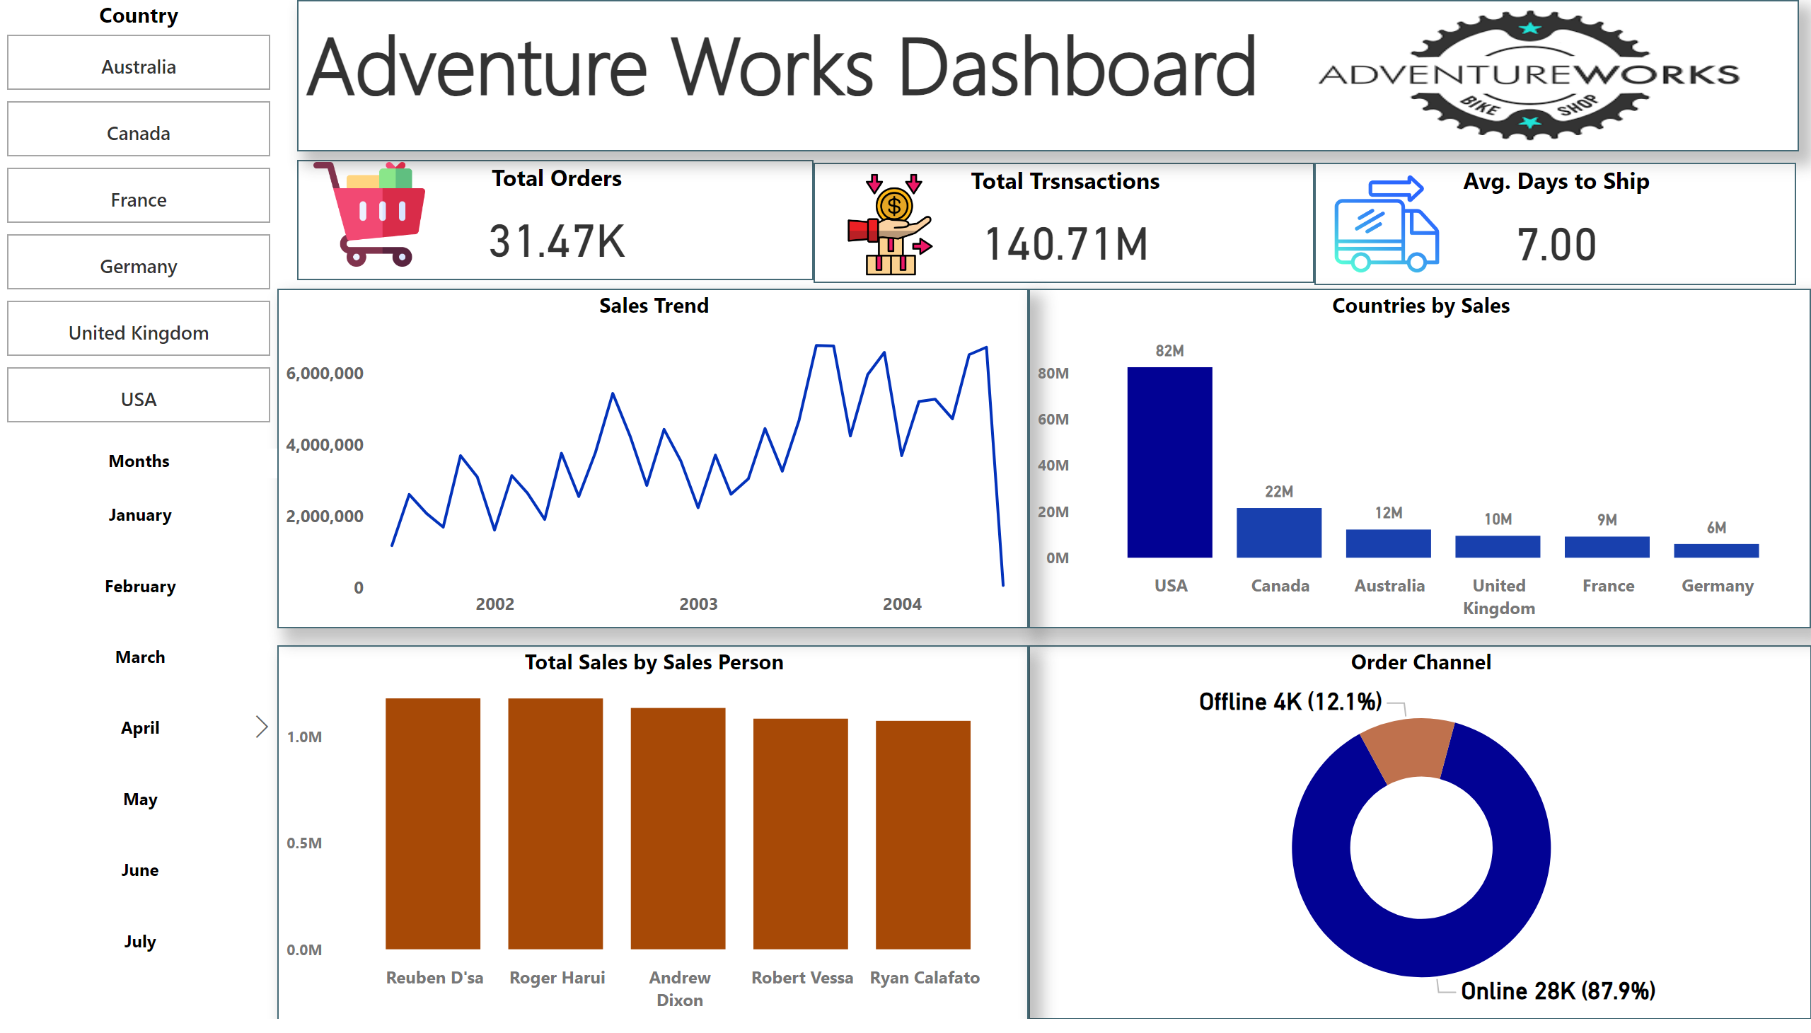
Dashboard
Notes:
Total Orders
No alt text provided
Total Trsnsactions
No alt text provided
Sales Trend
No alt text provided
textbox
No alt text provided
Avg. Days to Ship
No alt text provided
image
No alt text provided
image
No alt text provided
image
No alt text provided
image
No alt text provided
Order Channel
No alt text provided
Total Sales by Sales Person
No alt text provided
Countries by Sales
No alt text provided
Country
No alt text provided
Months
No alt text provided

Slide 3



Our Global Expedition
Our bicycle company has been on an incredible ride, crossing borders and connecting with customers globally. We've fulfilled over 31,470 orders since adventures started. Total Transactions: $140.71M But our journey isn't just about numbers – it's about the experiences we're creating for cycling enthusiasts worldwide, delivered to their doorsteps in just 7 days on average 7 days average to deliver those dreams
Key insight: Each order averages $4,470, indicating high-value products
Challenge: Can we reduce this to gain a competitive advantage?

Slide 4
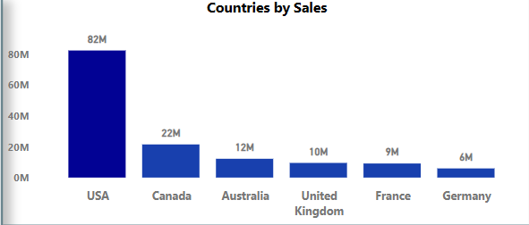
The World Map of Adventure Works
As we zoom out to view our global impact, we see a fascinating landscape. Picture this: the sprawling plains of the USA form our stronghold, contributing a whopping $82 million to our success. But our story doesn't end there. The snowy peaks of Canada and the sun-baked Outback of Australia are emerging as our new frontiers, each adding their unique flavor to our tale.
Significant presence in Canada, Australia, and Europe
Opportunity: Expand market share in European countries

Slide 5
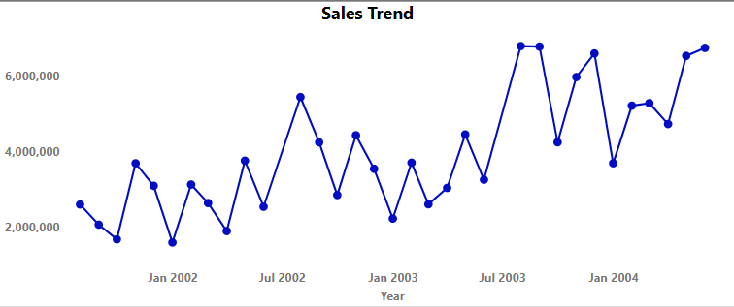
The Peaks and Valleys of Our Journey
Let's embark on a journey through Adventure Works' sales history. Like a thrilling bike ride, our path has been full of exhilarating climbs and swift descents. We started modestly in 2001, but look at how we've pedaled our way to new heights by 2004!
The trend appears to be generally increasing over time, with some fluctuations.
Recommendations:
Seasonal fluctuations present opportunities for targeted campaigns

Slide 6
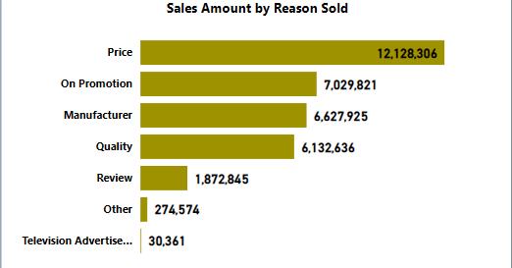
Why Customers Choose Us
Now, let's understand what makes our customers' wheels turn. Price leads the pack, showing that value matters most to our riders. But look closely - factors like promotions, manufacturer reputation, and quality follow closely behind.
It's like a well-oiled bike: price may be the frame, but it's the combination of all parts that creates a smooth ride. Even reviews play a role, reminding us that word-of-mouth can propel us forward.
Interestingly, TV advertising seems to have the least impact. Perhaps it's time to shift gears in our marketing strategy

Slide 7
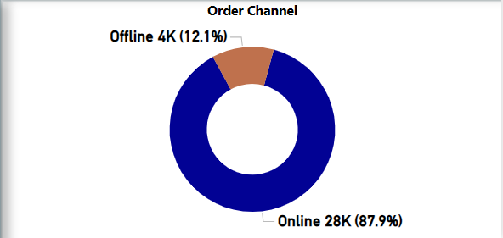
The Digital Revolution and Our Next Expedition
The digital age has transformed the landscape of our business. A staggering 87.9% of our orders now come through online channels. It's as if we've discovered a new, lightning-fast bike route that most of our customers prefer. We still have a valuable 12.1% of customers who prefer the scenic route - our offline channels.
Strategy: How do we enhance our digital highway while ensuring our traditional paths remain well-maintained?
Opportunity: Optimize the 12.1% offline orders

Slide 8
FOCUS AREAS
Develop training programs based on top-performer practices and create targeted plans for underperforming countries
Highlight opportunities for improving performance in lower-performing countries
European market expansion
E-commerce platform enhancement
Shipping time optimization
Sales team best practices sharing

Slide 9
Thank You!

